Slide 1

Medical Claim Fraud Detection Using Deep Neural Networks
OHSU - CS/EE 623 Deep Learning
Mohammad Salari

Slide 2
Agenda
Goal: build a two class, classifier
Medical claims from 2015 to 2018 with labels (Supervised learning)
Data preparation
Feature selection
Balancing data
Normalization
Architecture
Number of hidden layer and number of neurons
Result

Slide 3
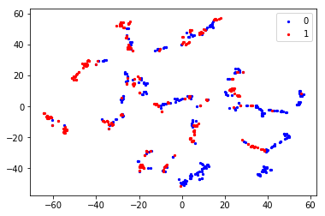
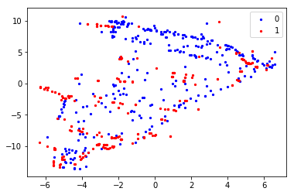
Choosing features
Visualizing high-dimensional data in a two or three-dimensional map
PCA and T-SNE by Laurens van der Maaten and Geoffrey Hinton
t-SNE

Slide 4


Imbalanced data
Data Set | Number of records
Non-fraud Claims | 47944216
Fraud | 15379
Non-fraud
Up Sampling ?
Didn’t get good result at the end.
Using less non fraud records instead of up-sampling fraud records
Sub samples must have a fair representation of non fraud data
$$Select ∗from Data$$
R(l,u) < A
R(l,u) as a rand generator function
l → lower band
u → upper band
A → fix number

Slide 5
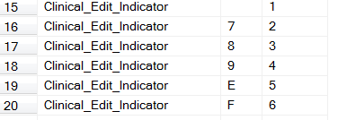
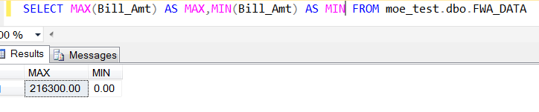
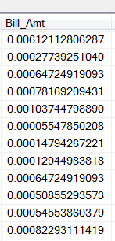
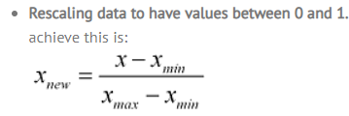


Encoding Strings and Standardize Data
From Scikit Learn Label Encoder
How it acts?
With empty or null values
Frequency of string!
SQL has been used:
Lookup Table

Slide 6
Data Preparation
Features Selected
Balance Data
Map to digits
Standardize
Deep Neural Networks Architecture
x
X = 14
H1 = 28
H2 = 28
.
.
.
.
.
.
.
.
.
.
.
Softmax → Y

Slide 7
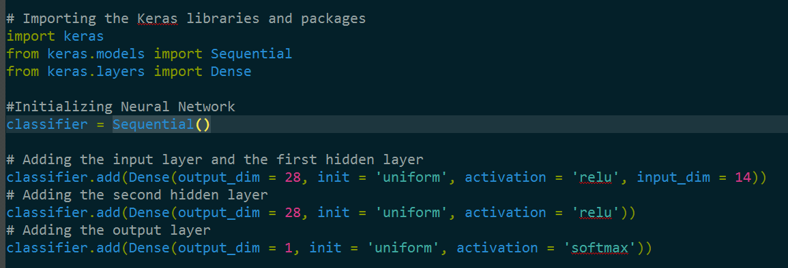
DNN Architecture
Uniform, lecun_uniform, normal, identity, orthogonal, one
glorot_normal: Gaussian initialization scaled by fan_in + fan_out (Glorot 2010)
glorot_uniform
he_normal: Gaussian initialization scaled by fan_in (He et al., 2014)
he_uniform
zero
Usage of initializations: https://faroit.github.io/keras-docs/1.2.2/initializations/

Slide 8
Keras parameters set…
Optimizer options
SGD
RMSprop
Adagrad
Adadelta
Adam
Adamax
Nadam
Loss
mean_squared_error
mean_absolute_error
mean_absolute_percentage_error
mean_squared_logarithmic_error
.
.
.
.
categorical_crossentropy
binary_crossentropy
Metric
Custom Accuracy
A metric is a function that is used to judge the performance of your model. A metric function is similar to a loss function, except that the results from evaluating a metric are not used when training the model.

Slide 9
Number of Epochs

Slide 10

Result
If the prediction be more than α then claim is belonging to fraud class.
α could be assign by the number of fraud records that expected
If α >> and we predict a record as a fraud, the probability of being true positive is high but we defiantly will loose lots of fraud records with low probabilities.
Using some pre-knowledge could help up for example:
y_pred > 0.4 and Amount > $1000

Slide 11



Result – Voting System
Random Forest
SVM
Nearest Neighbor
Boosted Trees
Decision Trees
Neural Networks
Prediction
Real
R
S
w1
w2
N
w3
∑
Keep those algorithms that have more weights
w4
Activation Function
B
w7
D
w6
w7
bias
N

Slide 12
Thanks

